Slide 1
Team 12 Members
Lê Đức Anh 20194416
Nguyễn Huy Hoàng 20194433
Presentation
MainMenuScreen
Input
SortingDemoScreen
SortingDemoScreen
BubbleSort
InsertionSort
QuickSort
ISortAlgorithm
SortArray

Slide 2
Problem Description
- Description:
Array is the most basic structure of computer science. Most operations as well as other data structures are built and performed on array. In this project, we will make an application in order to explain three sorting algorithms on array: bubble sort, quick sort and insertion sort.
- Requirements:
+ Must use pure array for the main data structure.
+ On the main menu:
3 types of sort algorithms to select.
Help menu show the basic usage and aim of the program.
Quit exits the program (must ask for confirmation).
+ In the demonstration:
User can choose to input an array or create an array randomly.
A back button to return to the main menu at any time.

Slide 3
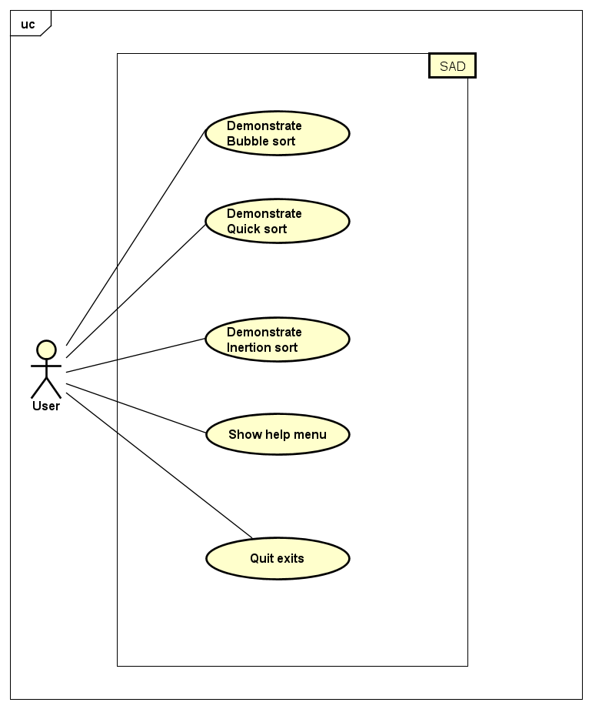
Usecase diagram

Slide 4
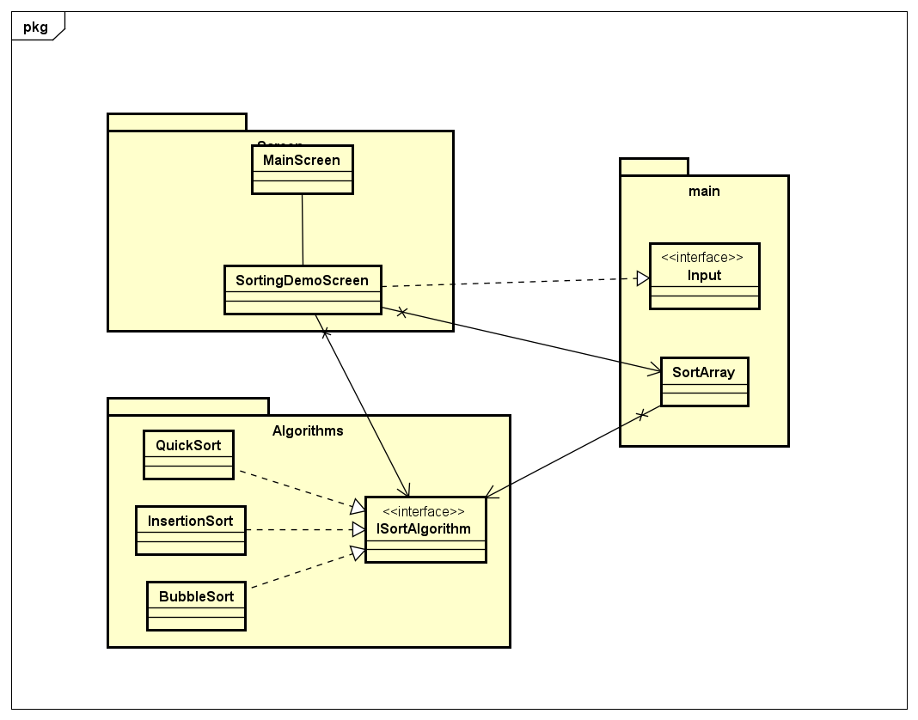
General class diagram
3 main packages:
algorithms package
main package
screen package

Slide 5
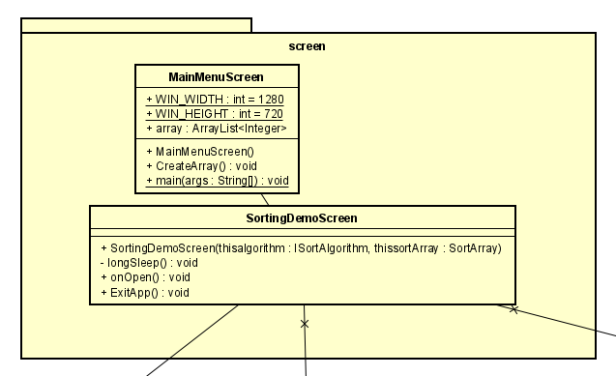
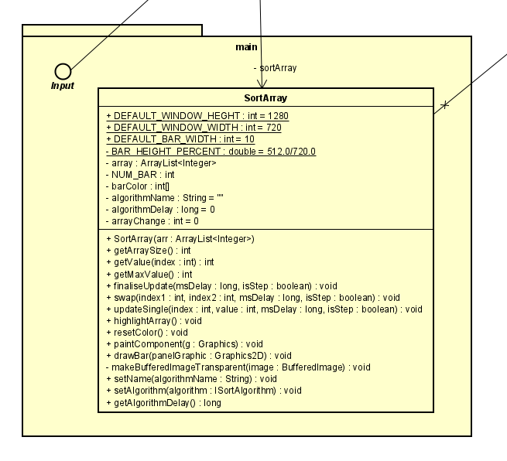
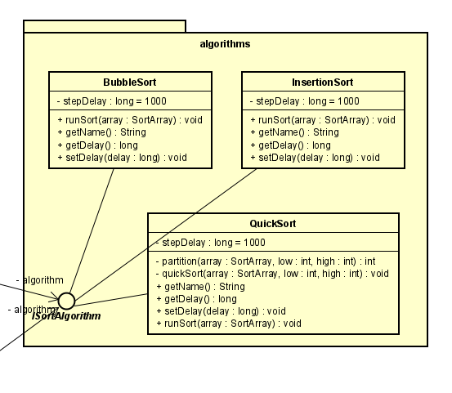
Class diagram for package
Venus
Mercury

Slide 6
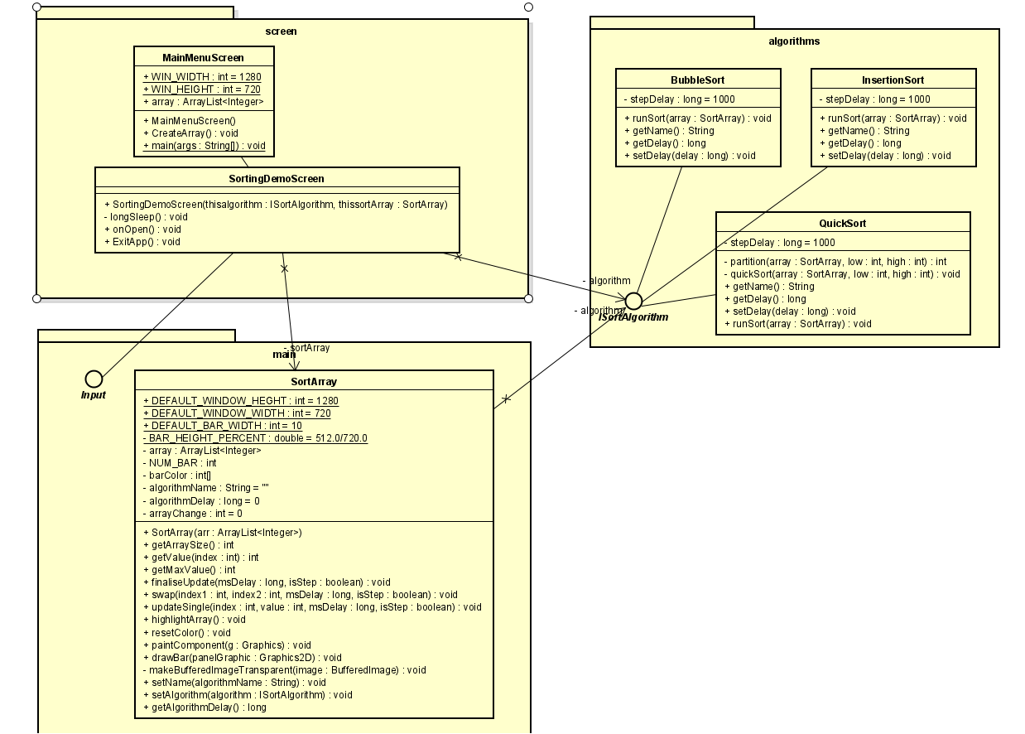
Class diagram
02
You can insert here a subtitle if you need it

Slide 7
In the SortArray class, there will be some the method like swap(), updateSingle() so that the above algorithms can use in the sorting process. Moreover, this class also override the paintComponent() method with the drawBar() and drawBufferedImageTransparent() to visualize the array. We use Thread.sleep() method at each time there is a change in the array and repaint the array.

Slide 8
The SortingDemoScreen constructor will have two parameter, they are the instance of ISortingAlgorithm (to know which algorithm it will demonstrate) and the instance of SortArray (to paint the array). It also connects to the Input interface to take the array (whether it is created manually or randomly).
MainMenuScreen will display the main menu to choose including choose type of algorithm to visualize, help and exits.

Slide 9
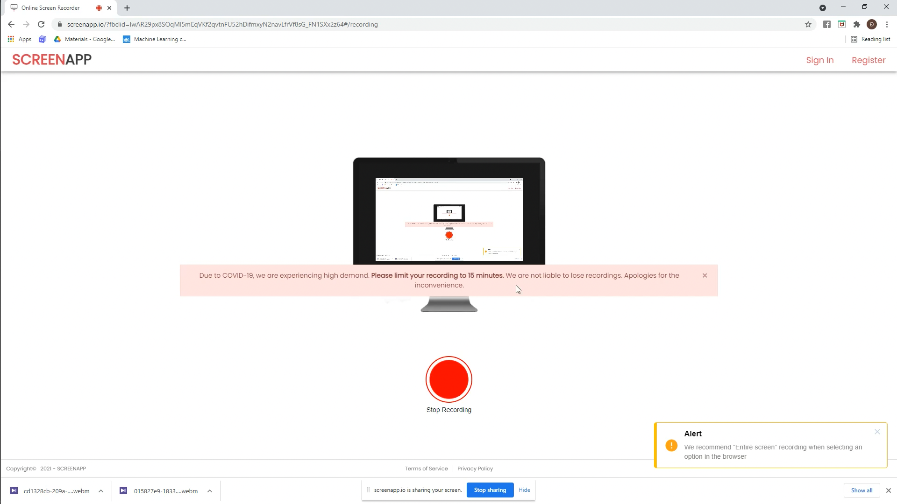
Link Demo Video: https://drive.google.com/drive/folders/1eRUhNUoVMJH59t_TcnSg_TmORpPGpaXY?usp=sharing

